Slide 1
Data Analysis & GeoSpatial Visualization
US Crude Oil Imports

Slide 2
Table of contents
01
02
03
04
Exploratory Data Analysis
Outlier Detection and Handling
Unveiling Insights through Data Cleaning and Manipulation
Methodologies and treatments of outliers
Analysis & Dashboard with Excel
Analysis & Dashboard with Power BI
Unlocking Insights: Data Analysis and Visualization in Excel
Interactive Power BI Dashboard for actionable insights.

Slide 3
Preface:
Using visualizations and statistical techniques, we aim to uncover key insights, trends, and correlations in U.S. crude oil imports.
These findings offer valuable information for stakeholders such as policymakers, investors, and industry professionals.
This analysis explores various factors such as year, month, origin name, origin type name,destination name,destination type name,grade name and quantity.

Slide 4
Environment Setup
There are various approaches for setting up an environment for Data Analysis and Data Visualization. Some of them are:
Approach | Purpose
VS Code | Exploratory Data Analysis (EDA)
Ms Excel | Data Analysis & Visualisation
Power BI Desktop | Data Visualisation

Slide 5
01
Exploratory Data Analysis
Data preprocessing

Slide 6

Data Cleaning and Data Manipulation
Imported are some of the packages like pandas, numpy, matplotlib and seaborn for data analysis and data manipulation
Pandas for Data Analysis
Numpy for Numerical Operations
Matplotlib and Seaborn for Data Visualisation.
Later, we have read the CSV file using pandas and DataFrame is formed.

Slide 7
It is to be known that this dataset has 4,83,053 rows × 8 columns as determined by using df.shape .
The dataset does not have any missing values and duplicate values.
Utilised df.describe() to get the Statistical Summary.
After using df.unique() to identify unique values in each column, it was discovered that "Country not known" is present in the ‘origin name’ column. Therefore, it was removed as it is not suitable for data analysis.
Substituted 'the Bahamas' with 'Bahamas' and 'South Sudan' with 'Sudan' to facilitate geospatial analysis.
Transformed and type casted the data type of 'year' column from integer to text and changed the ‘month’ column from number to month name to make it suitable for the analysis.
Utilized value_counts() to understand the distribution of grade names, noting that 'Heavy sour' had the highest volume of imports.

Slide 8
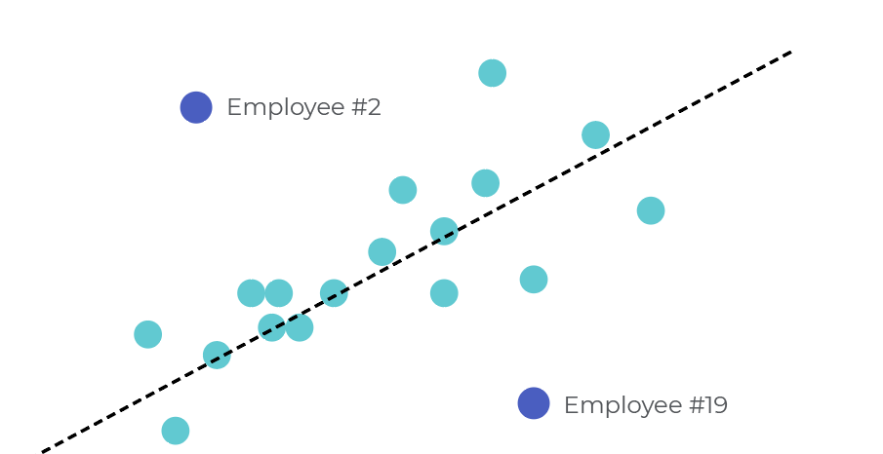
02
Outlier Detection & Handling
Target variable is ‘quantity’.

Slide 9
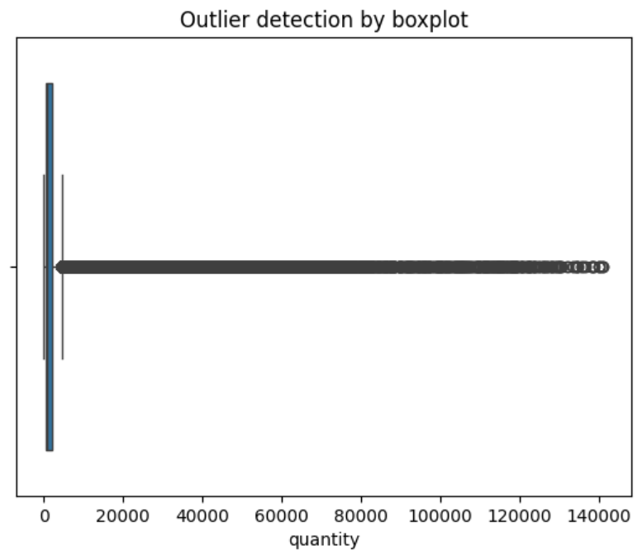
Outlier Detection
Box-plot is used to visually detect the outliers.
Getting the outliers using IQR method where quantile of Q1 is set to 0.25 and Q3 is set to 0.595.
Total no. of outliers: 1,14,690
Before removing outliers: 4,83,018
After removing outliers: 3,68,328
Percentage of data loss: 23.74 %

Slide 10
Treatments to handling outliers
Trimming
Capping
Remove the outliers completely.
Replace the outliers with Upper value.
Transform (log)
Winsorization
Replace the outliers with log of itself.
Replace the outliers closer to the central part.
Z-Score + IQR
Replace the outliers first with Z-Score and then those with IQR.

Slide 11
Statistics on Treatments
Method/Stats | Original | Trimming | Capping | Transforming | Winsorization | Z-Score+IQR
Records | 483018 | 366586 | 483018 | 483018 | 483018 | 483018
Mean | 2425.35 | 683.93 | 1091.03 | 528.62 | 1401.10 | 1416.78
Std | 6367.91 | 529.56 | 857.72 | 551.45 | 1412.70 | 1445.67
Max | 141016.0 | 2017.0 | 2393.50 | 2096.0 | 4349.0 | 4481.5

Slide 12
GeoSpatial Analysis
Install and import Geopandas Library.
'Naturalearth_lowres' is map dataset which is built-in dataset provided by GeoPandas.
Includes geometrical shapes representing the boundaries of the countries.
The map dataset is read and GeoDataFrame is formed which is then compared with the our DataFrame to plot map.

Slide 13
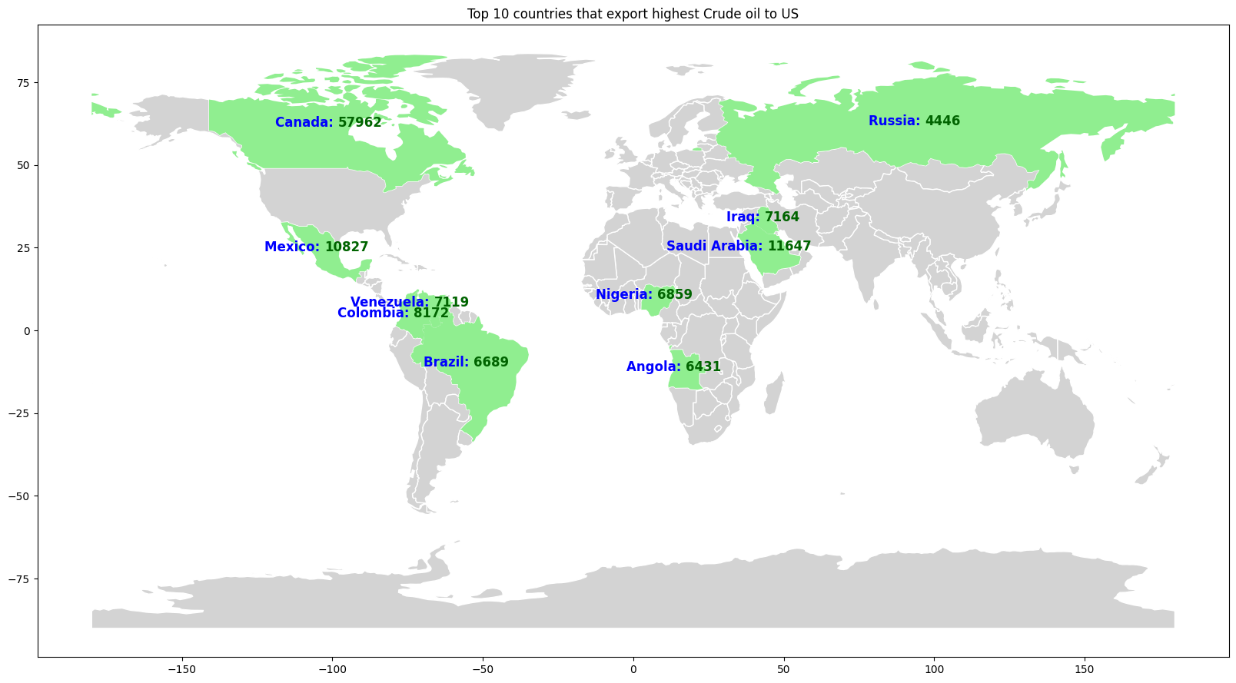
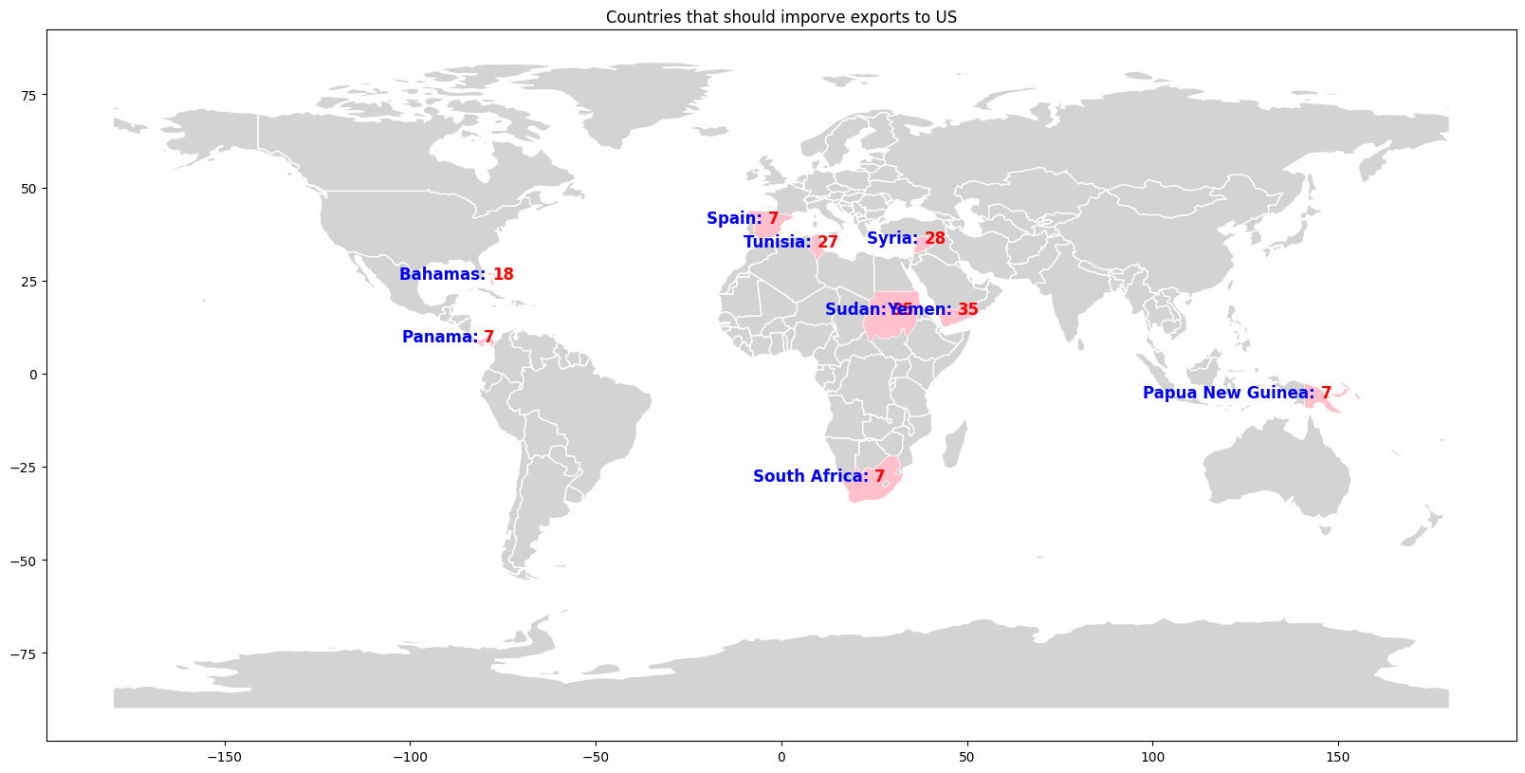
GeoSpatial Analysis
Top Countries with highest export to US
Least Countries with lowest export to US

Slide 14
03
Analysis & Dashboard with Excel

Slide 15
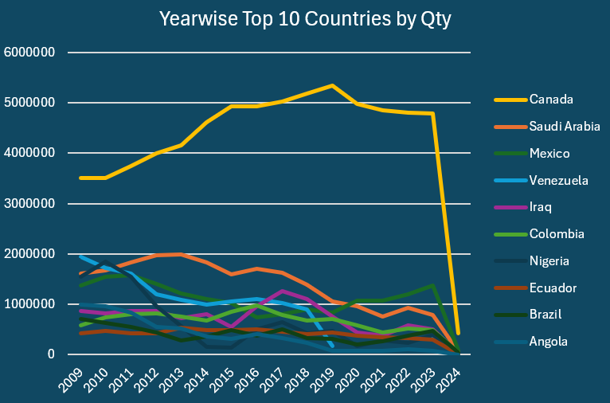
Quantity by Top 10 countries:
This Charts shows year-wise the top 10 countries by Quantity.
Canada stands first with the Quantity supply to US.
We can see the Venezuela has given supply till 2019 and with break of 3 year it started in 2023.

Slide 16
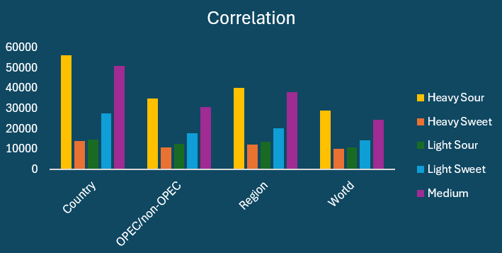
Correlation between origintype and gradename:
Analyzing the chart, it's evident that the "country" origin type leads in grade quantity. Specifically, it tops the list in the "Heavy sour" grade while ranking lowest in the "Heavy sweet" category.

Slide 17
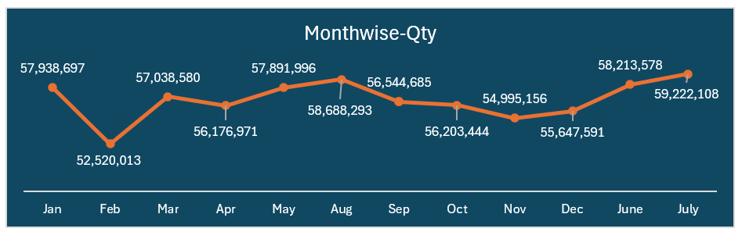
Seasonal Trends:
This chart shows the Seasonal trends in the Month-wise Quantity.
Since 2024 has one month ie. Jan so the graph shows highest Quantity for January.
So, above chart is from years 2009-2023 which has all month for each year ,July has highest and February has the lowest quantity.

Slide 18
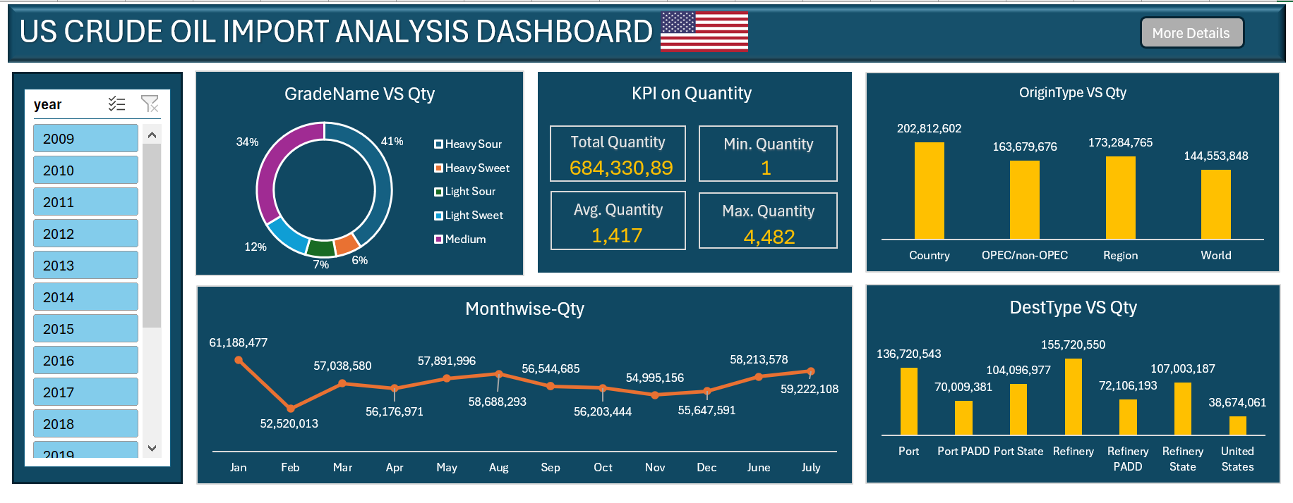
Excel Dashboard

Slide 19
04
Analysis & Dashboard with Power BI

Slide 20
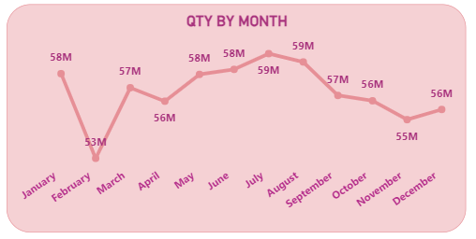
Quantity by Month Type:
The Line chart illustrates the quantity of imports by month.
In the year 2024 we have only one month i.e is January. So, analysis is done from 2009 -2023.
Revealing that month of July and August has the highest records of imports with 59 M.
While month of February has the least record of imports with 53 M.

Slide 21
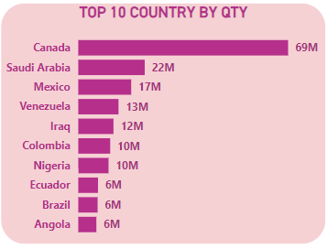
Top 10 Country by Quantity :
The Clustered bar chart illustrates the top 10 countries by Quantity .
Providing a visual comparisons of their respective imports volumes.
Canada has the highest volume of imports with 69M from the top 10 countries
.

Slide 22
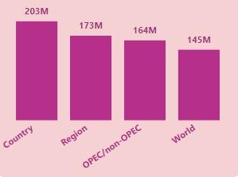
Quantity by Origin Type:
The bar chart illustrates the Quantity by Origin type .
Country has the highest volume of import records with 203 M.
World has the lowest volume of import records with 145 M.

Slide 23
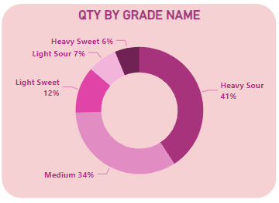
Quantity by Grade Name :
Donut chart represents the Quantity by Origin Name.
Heavy sour has the maximum record of imports with 41% of quantity.
Heavy sweet has the minimum record of imports with 6% of quantity.

Slide 24

KPI’s :
KPI is an Key Performance Indicator used to evaluate performance and to track progress over the time.
Created a dynamic Power BI dashboard and reports to visualize key performance indicators (KPIs).
Created five KPIs using the column ‘quantity’ which is ,Total quantity,Maximum quantity,Minimum quantity,Average quantity ,Grade of the oil.

Slide 25
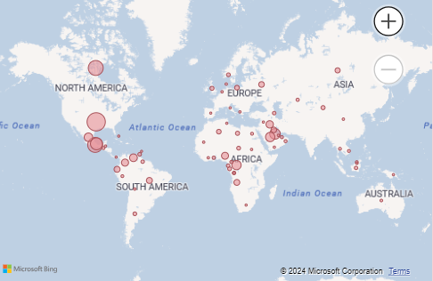
Quantity by Origin Name :
Used Power BI charting tools to create a map visualization.
In this map visualization plots on the ‘Origin Name’ and ‘Quantity’.
Here the Pink bubble shows the area that has exported the quantity to the US.
Variation of the bubble sizes indicates the ‘OriginName’ that has highest quantity.

Slide 26
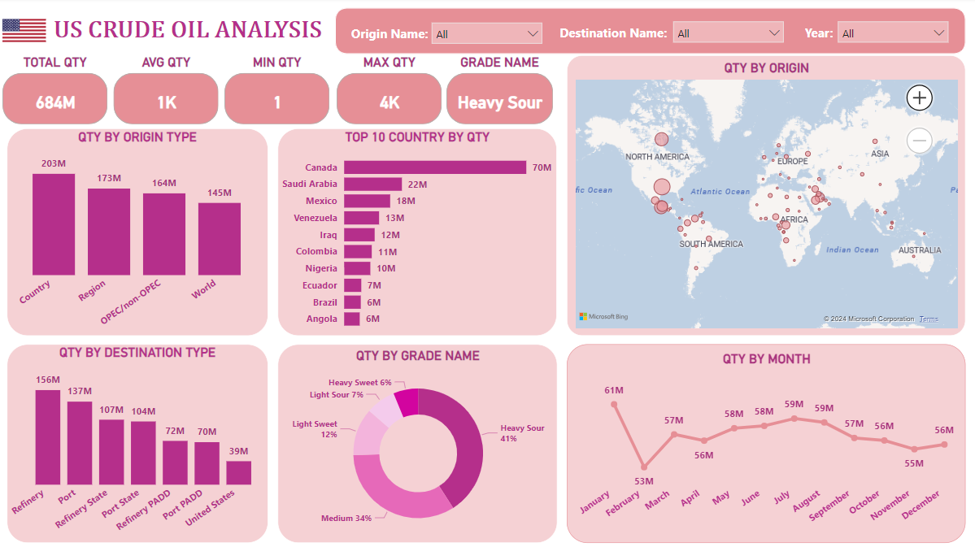
FINAL DASHBOARD OF POWER BI:

Slide 27
Reference
https://github.com/HarshithaShenava/US-Oil-import-Analysis-Python-Excel-Power-BI
https://github.com/Gayathrikaveri/US-CRUDE-OIL-ANALYSIS--PYTHON-EXCEL-POWER-BI
https://github.com/KeerthiJyoshna97/US-Crude-Oil-Imports-Analysis-EDA-Excel-Power-BI
https://github.com/SugeshKumarR/US-Crude-Oil-import-Analysis-Python-Excel-Power-BI

Slide 28
Thank
You!

